Slide 1
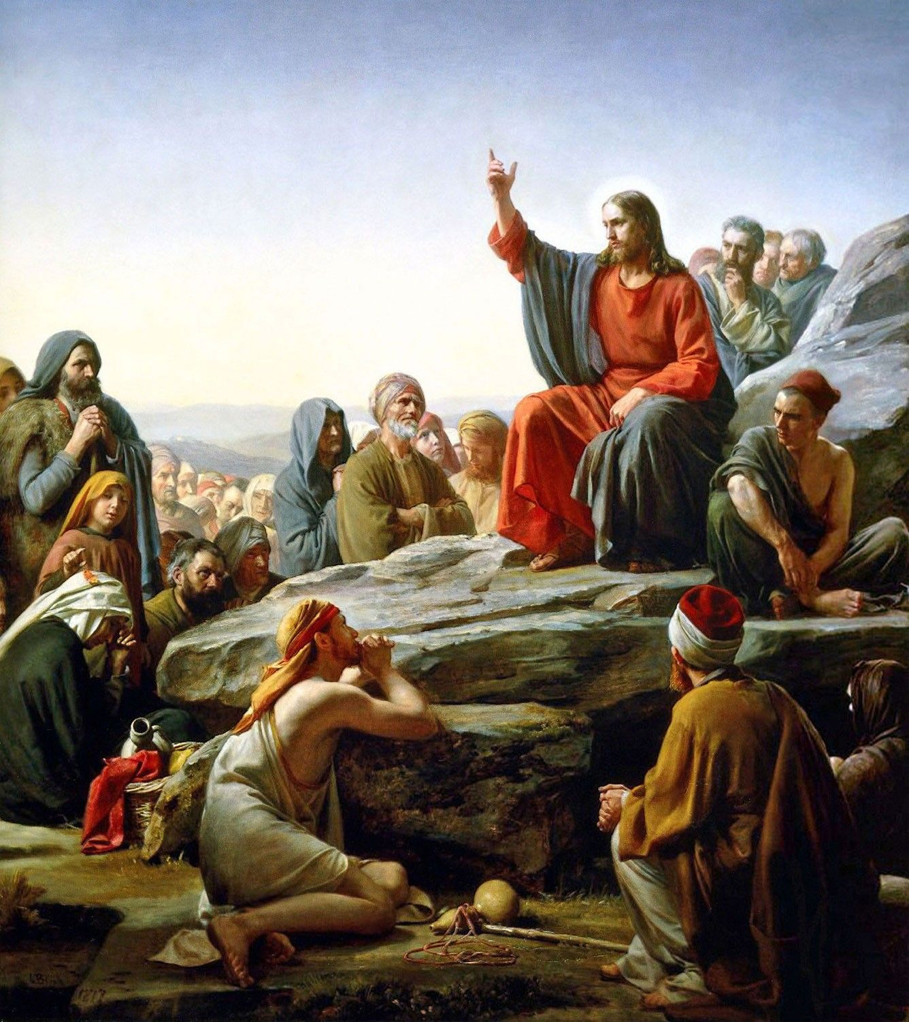
THE LIFE OF CHRIST
PART 23

Slide 2
Matthew 5:13 " You are the salt of the earth; but if the salt loses its flavor, how shall it be seasoned? It is then good for nothing but to be thrown out and trampled underfoot by men.

Slide 3
Mark’s account says:
Mark 9:50 "Salt is good, but if the salt loses its flavor, how will you season it? Have salt in yourselves, and have peace with one another."

Slide 4
Luke’s account says:
Luke 14:34 " Salt is good; but if the salt has lost its flavor, how shall it be seasoned? ³⁵ "It is neither fit for the land nor for the dunghill, but men throw it out. He who has ears to hear, let him hear!"

Slide 5
A king summons his three beautiful daughters and asked them how much they loved him. The first daughter said, “Father, I love you more than all the riches of your empire. More than all the gold and silver and the precious stones and lands and houses.” This saying impressed the king with the claim of devotion.
The second daughter said, “Father, I love you more than pomp and pleasure of the court. More than all the rich foods, beautiful clothes, and music. More than the balls and expensive carriages and good times of the empire. This answer pleased the king.

Slide 6
When the third, youngest daughter was asked the same question, her simple answer shocked the king because she said, “Father, I love you more than salt.” The king was not pleased with her response and he argued with her and shamed her in front of everyone for her lack of devotion.

Slide 7
The court chef heard how the king was treating the younger daughter about her response, so he decided to teach the king a lesson by not putting any salt on the food at the next meal. When the king began to eat, he started complaining about how bland the food was, then the cook told king, “Sire, I left the salt out of the cooking today so you might know how much your youngest daughter truly loves you.”

Slide 8
The king got the message and called his youngest daughter to him and gathered her into his bosom and thanked her and apologized for being so short sighted. He realized how indispensable salt really is and concluded that his youngest daughter loved him more and was more devoted to him than his other daughters.

Slide 9
Job 6:6 Can flavorless food be eaten without salt?

Slide 10
Leviticus 2:13 'And every offering of your grain offering you shall season with salt; you shall not allow the salt of the covenant of your God to be lacking from your grain offering. With all your offerings you shall offer salt.

Slide 11
Colossians 4:6 Let your speech always be with grace, seasoned with salt, that you may know how you ought to answer each one.

Slide 12
Matthew 23:13 "But woe to you, scribes and Pharisees, hypocrites! For you shut up the kingdom of heaven against men; for you neither go in yourselves, nor do you allow those who are entering to go in. ¹⁴ "Woe to you, scribes and Pharisees, hypocrites! For you devour widows' houses, and for a pretense make long prayers. Therefore you will receive greater condemnation. ¹⁵ "Woe to you, scribes and Pharisees, hypocrites! For you travel land and sea to win one proselyte, and when he is won, you make him twice as much a son of hell as yourselves.

Slide 13
Genesis 18:23 And Abraham came near and said, "Would You also destroy the righteous with the wicked? ²⁴ "Suppose there were fifty righteous within the city; would You also destroy the place and not spare it for the fifty righteous that were in it? ²⁵ "Far be it from You to do such a thing as this, to slay the righteous with the wicked, so that the righteous should be as the wicked; far be it from You! Shall not the Judge of all the earth do right?" ²⁶ So the LORD said, "If I find in Sodom fifty righteous within the city, then I will spare all the place for their sakes."

Slide 14
²⁷ Then Abraham answered and said, "Indeed now, I who am but dust and ashes have taken it upon myself to speak to the Lord: ²⁸ "Suppose there were five less than the fifty righteous; would You destroy all of the city for lack of five?" So He said, "If I find there forty-five, I will not destroy it." ²⁹ And he spoke to Him yet again and said, "Suppose there should be forty found there?" So He said, "I will not do it for the sake of forty." ³⁰ Then he said, "Let not the Lord be angry, and I will speak: Suppose thirty should be found there?" So He said, "I will not do it if I find thirty there."

Slide 15
³¹ And he said, "Indeed now, I have taken it upon myself to speak to the Lord: Suppose twenty should be found there?" So He said, "I will not destroy it for the sake of twenty." ³² Then he said, "Let not the Lord be angry, and I will speak but once more: Suppose ten should be found there?" And He said, "I will not destroy it for the sake of ten." ³³ So the LORD went His way as soon as He had finished speaking with Abraham; and Abraham returned to his place.

Slide 16
Matthew 5:43 " You have heard that it was said, 'You shall love your neighbor and hate your enemy.' ⁴⁴ "But I say to you, love your enemies, bless those who curse you, do good to those who hate you, and pray for those who spitefully use you and persecute you, ⁴⁵ "that you may be sons of your Father in heaven; for He makes His sun rise on the evil and on the good, and sends rain on the just and on the unjust. ⁴⁶ "For if you love those who love you, what reward have you? Do not even the tax collectors do the same? ⁴⁷ "And if you greet your brethren only, what do you do more than others? Do not even the tax collectors do so? ⁴⁸ "Therefore you shall be perfect, just as your Father in heaven is perfect.

Slide 17
but if the salt loses its flavor, how shall it be seasoned? It is then good for nothing but to be thrown out and trampled underfoot by men.

Slide 18
Regarding the question of salt's losing its savor, Elmer W. Maurer, research chemist with the United States Department of Agriculture and a brilliant contemporary scientist, made this interesting reference to this portion of the Saviour's teachings:

Slide 19
Salt was accepted and collected as taxes by the Romans from the people of the Holy Land. One of the main sources of salt for Palestinians, of course, was the Dead Sea, or Salt Sea. So oppressive were these taxes that the people adulterated the salt with sand or other earthy material (the salt to begin with was not our nice pure table salt). The government purified the salt by spreading it in big vats or tanks, filling them with water and drawing off the concentrated salt solution or brine. All that remained was the earthy, insoluble material. Indeed, the salt had lost its savor because it was no longer salt. It was fit to be trodden underfoot.

Slide 20
And this was not the only way that salt could lose its savor. The surface waters of the Dead Sea, on evaporation, have a chemical salts content of about 31 percent sodium chloride, 13 percent calcium chloride, and 48 percent magnesium chloride, together with other impurities. The calcium and magnesium chlorides are hygroscopic (take water out of the air) and will thus literally dissolve the sodium chloride. A bitter tasting composition results. It was the custom to store vast amounts of this salt in houses that had earthen floors. In time, the salt next to the ground spoiled because of the dampness.

Slide 21
Since it would be harmful to fertile land because of its salt content, no man would allow it to be thrown on his field. The only place left was the street, where it was trodden under foot of man. Thus the Bible was proved scientifically accurate, even in its many small details - for this was just a lone example.[8]

Slide 22
Matthew 5:14 "You are the light of the world. A city that is set on a hill cannot be hidden. ¹⁵ "Nor do they light a lamp and put it under a basket, but on a lampstand, and it gives light to all who are in the house. ¹⁶ "Let your light so shine before men, that they may see your good works and glorify your Father in heaven.

Slide 23
Ephesians 5:8 For you were once darkness, but now you are light in the Lord. Walk as children of light ⁹ (for the fruit of the Spirit is in all goodness, righteousness, and truth), ¹⁰ finding out what is acceptable to the Lord. ¹¹ And have no fellowship with the unfruitful works of darkness, but rather expose them. ¹² For it is shameful even to speak of those things which are done by them in secret. ¹³ But all things that are exposed are made manifest by the light, for whatever makes manifest is light.

Slide 24
John 3:19 "And this is the condemnation, that the light has come into the world, and men loved darkness rather than light, because their deeds were evil.

Slide 25
John 1:4 In Him was life, and the life was the light of men. ⁵ And the light shines in the darkness, and the darkness did not comprehend it. ⁶ There was a man sent from God, whose name was John. ⁷ This man came for a witness, to bear witness of the Light, that all through him might believe. ⁸ He was not that Light, but was sent to bear witness of that Light. ⁹ That was the true Light which gives light to every man coming into the world.

Slide 26
John 8:12 Then Jesus spoke to them again, saying, "I am the light of the world. He who follows Me shall not walk in darkness, but have the light of life."

Slide 27
A city that is set on a hill cannot be hidden. ¹⁵ "Nor do they light a lamp and put it under a basket, but on a lampstand, and it gives light to all who are in the house. ¹⁶ "Let your light so shine before men, that they may see your good works and glorify your Father in heaven.

Slide 28
Psalm 27:1 The LORD is my light and my salvation; Whom shall I fear? The LORD is the strength of my life; Of whom shall I be afraid?

Slide 29
1 Peter 2:9 But you are a chosen generation, a royal priesthood, a holy nation, His own special people, that you may proclaim the praises of Him who called you out of darkness into His marvelous light;

Slide 30
1 John 1:5 This is the message which we have heard from Him and declare to you, that God is light and in Him is no darkness at all. ⁶ If we say that we have fellowship with Him, and walk in darkness, we lie and do not practice the truth. ⁷ But if we walk in the light as He is in the light, we have fellowship with one another, and the blood of Jesus Christ His Son cleanses us from all sin.

